Slide 1
Image Segmentation Using U-Net
By:→ Chinmay.

Slide 2
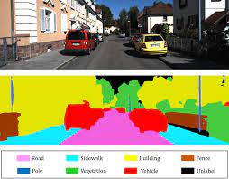
Image Segmentation
Image segmentation is a method in which a digital image is broken down into various subgroups called Image segments which helps in reducing the complexity of the image to make further processing or analysis of the image simpler.

Slide 3
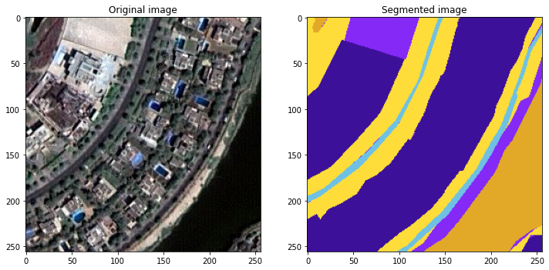
Data Collection
The data for this project is taken from kaggle.
Our data consists of two types of images: satellite images with their masked images and

Slide 4
What is U-Net ?
U-Net is a CNN-based neural network architecture.
The U-Net architecture was introduced for biomedical image segmentation by Olag Ronneberger.
The introduced architecture had two main parts, which were the encoder and the decoder.
The encoder is used to extract the information from the image pixel by pixel.
The second part decoder uses transposed convolution to permit localization.

Slide 5
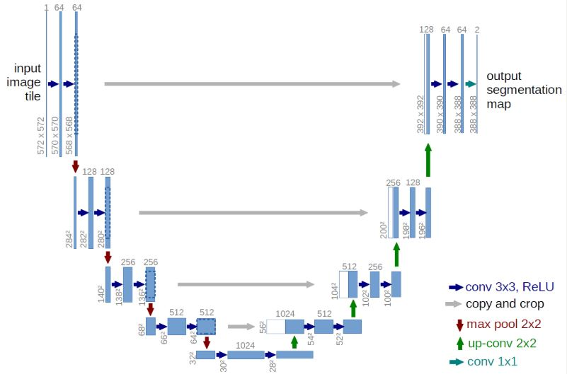

Slide 6
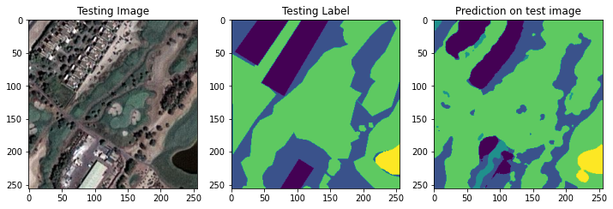
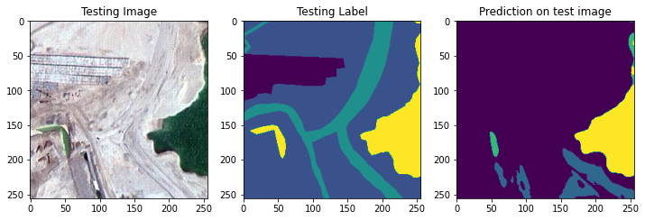
The Model's Outcome

Slide 7
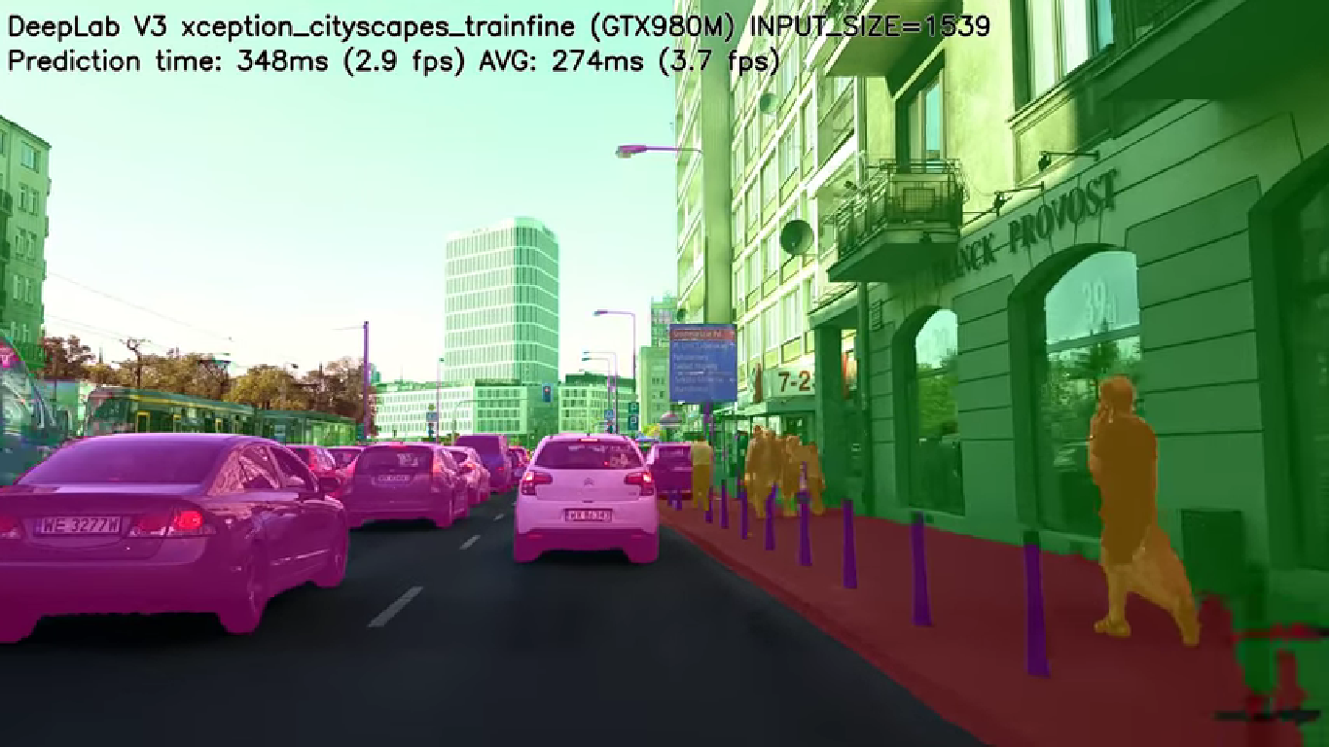
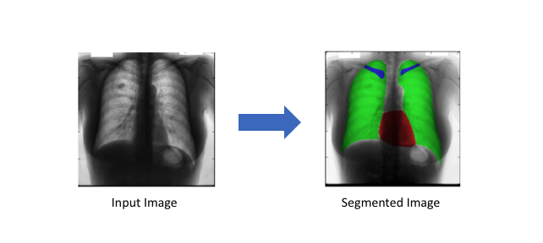
Other Applications Of Image Segmentation
Autonomous vehicles
We need to equip cars with the necessary perception to understand their environment so that self-driving cars can safely integrate into our existing roads.
Medical image diagnostics
Machines can augment analysis performed by radiologists, greatly reducing the time required to run diagnositic tests.

